Slide 1
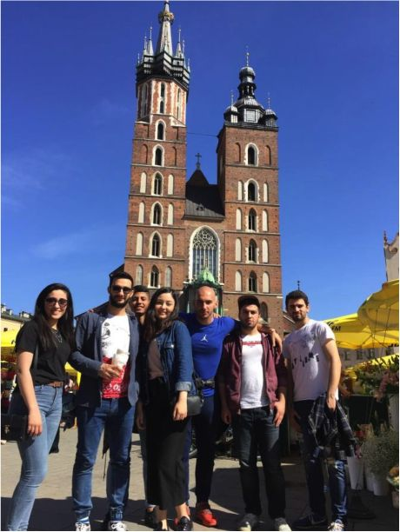
My Erasmus Adventure
Poland was one of the countries I wonder. I met a lot new friends and teachers. I saw there are lots of differences between Turkish and Polish culture. I have been some cities in Poland, and there are Old Towns each cities, that’s the best point why I like about Poland. Old Towns have old buildings and big squares. It smells like nostalgia! Big cities have big Old Towns, and generally city center is near old towns, except of Warsaw! In my opinion, the best old town in Krosno. It is such a pretty old town. That might be because I have my best memories with my friends in Old Town!
Krakow is such a big and historical city in Poland. I think it is like our Istanbul in Turkey, it has castle, historical buildings and places. Krakow is my favourite city in Poland because it hosts modernism and nostalgia. Krakow’s old town is one of big old towns of Poland. I like to tour Krakow on foot! A photo from Krakow tour:

Slide 2
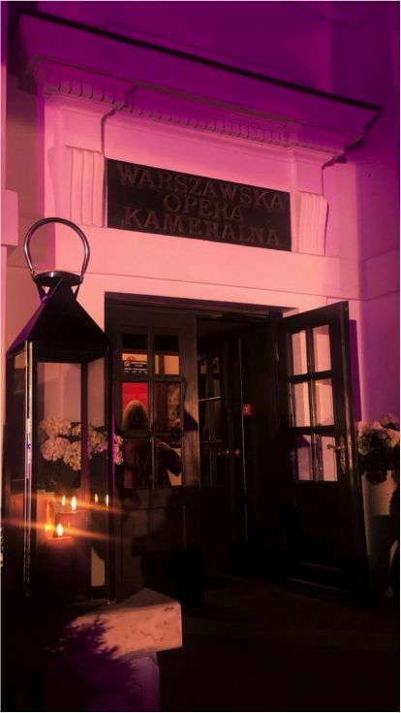
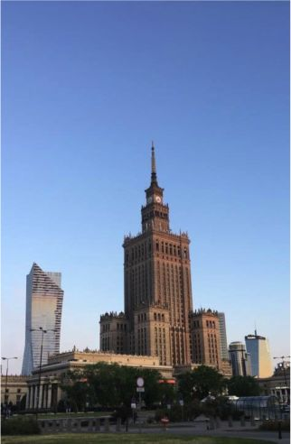
The best thing I like about Warsaw is there are lots of theatres, operas and museums.
The view from Science and Culture Palace from 31st floor was amazing, palace was
amazing also!

Slide 3
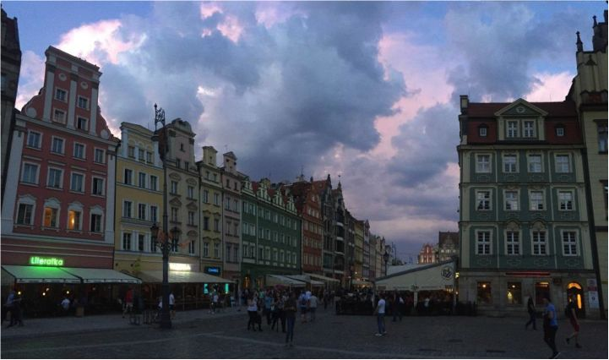
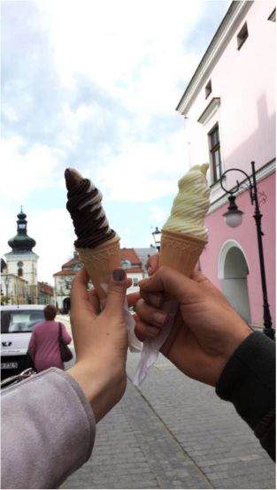
Wroclaw’s Old Town was the most colourful one!
Polish ice-cream looks very nice as well as very tasty.

Slide 4
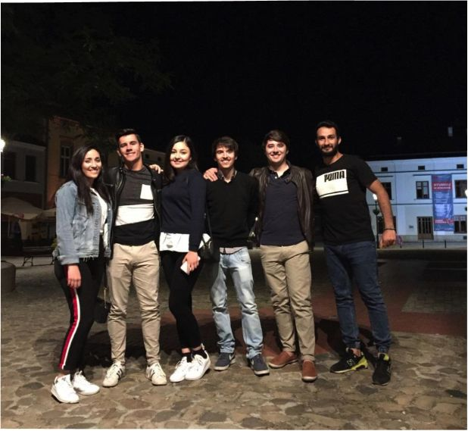
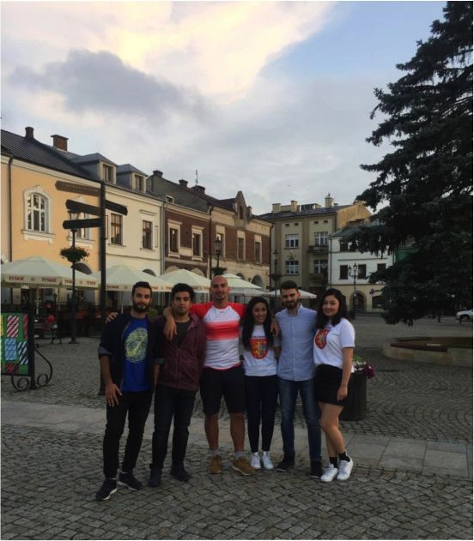
I met Portuguese people in Krosno! We told our culture each other.
We ate Pierogi, and it was very delicious. To be honest, Poland is more magnificent than I thought. Thank you Poland to give me amazing friends, amazing memories!
PWMU.MLSK

